Slide 1

Data Acquisition, Storage, and Linkage
Rayid Ghani and Kit Rodolfa

Slide 2
Short Quiz on Lecture Video

Slide 3
Weekly Review Feedback
The weekly review forms are a forum for you to provide feedback about what you’re learning and how the class is going
Some common themes from last week:
Class discussions
Getting set up with the course technology
Finding course materials/announcements

Slide 4






Class Infrastructure Elements:
GitHub Server
Amazon Web Services
Your Laptop
Class Server mlpolicylab.dssg.io
Class Database mlpolicylab.db.dssg.io
VPN

Slide 5
Class Infrastructure Elements: When you ssh to mlpolicylab.dssg.io
GitHub Server
Amazon Web Services
Your Laptop
Class Server mlpolicylab.dssg.io
Class Database mlpolicylab.db.dssg.io
VPN

Slide 6
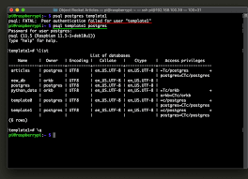
Class Infrastructure Elements: When you use psql from the class server
GitHub Server
Amazon Web Services
psql
Your Laptop
Class Server mlpolicylab.dssg.io
Class Database mlpolicylab.db.dssg.io
VPN
psql Client

Slide 7
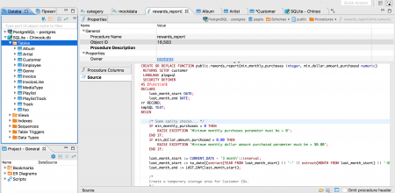
Class Infrastructure Elements: When you use dbeaver to connect to the database
GitHub Server
Amazon Web Services
SSH Tunnel
Your Laptop
Class Server mlpolicylab.dssg.io
Class Database mlpolicylab.db.dssg.io
VPN
dbeaver Client

Slide 8


Class Infrastructure Elements: When you use Jupyter
GitHub Server
Amazon Web Services
Your Laptop
Class Server mlpolicylab.dssg.io
Class Database mlpolicylab.db.dssg.io
VPN
SSH Tunnel +
Jupyter Server
Browser

Slide 9

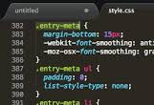
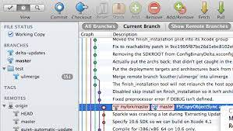
Class Infrastructure Elements: When edit code with a local text editor
GitHub Server
Amazon Web Services
Git CLI
Your Laptop
Class Server mlpolicylab.dssg.io
Class Database mlpolicylab.db.dssg.io
VPN
Text
Editor
Git
Client

Slide 10
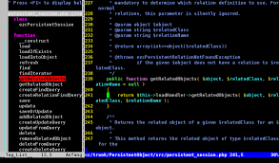
Class Infrastructure Elements: When edit code with a remote text editor
GitHub Server
Amazon Web Services
Git CLI
Your Laptop
Class Server mlpolicylab.dssg.io
Class Database mlpolicylab.db.dssg.io
VPN
Text Editor

Slide 11
Things to remember
We’ll finish setting up your project teams by tomorrow (Friday)
Make sure and check that you can access your project data before class on Tuesday
What’s coming next week:
Assignment
Weekly review
Getting and Loading ACS Data
Readings
Make sure to read project proposal preparation guidelines

Slide 12
Scope
Data
Exploration
Modeling
Get Data
Store Data
Link Data
Rows
Features
Labels
Model Selection
Train-Test Splits
Performance Metrics
Model Interpretation
Entities
temporal
Spatial
…
Models
Dealing with Bias and Fairness
Field Trial Design
Deployment
Monitoring
Goals, Actions, Data, Analysis, Ethics

Slide 13
Plan for today
We covered the conceptual material about acquiring data & record linkage in the video you watched before class. So we’ll spend this session discussing:
Working together with your project team
Bias and fairness considerations with record linkage
Your experiences with acquiring data for projects

Slide 14
Working with Your Project Team
Teams designed to balance skills, backgrounds, and experiences
Spend some time up front figuring out how to work as a team and work styles
Everyone should participate in all aspects of project
No individual should do the majority of the python coding, SQL writing, report writing
However, you should divide up different pieces of the work
For instance, working on different parts of the pipeline code in parallel or splitting up sections of the report

Slide 15
Working with Your Project Team
We’re providing class time to make it easier to coordinate with your group and get feedback from peers and instructors, but you won’t be able to complete the project just in this allotted time
Tools for coordination:
Slack: we’ve created group-level and project-level channels. Additionally, feel free to use group DMs and video calls with your group to coordinate as well.
Many good free options for task tracking/management: github issues or project boards, trello, etc.

Slide 16
Working with Your Project Team
Active participation in the group work throughout the entire semester is required by all the team members, and a very large component of your grade
Collaboration is encouraged, both within and across teams! Learning from each others’ strengths is a big benefit of group work, and you should feel free to discuss strategies and approaches with other teams (i.e., it’s not a competition)
Pacing your work is important. You won’t be able to do everything the week before the final report, and if everyone tries to, you’ll break the server.

Slide 17
DISCUSSION QUESTION
Past experiences with project groups or questions/feedback about this semester?

Slide 18
Any questions from the video lecture?

Slide 19
DISCUSSION QUESTION
What are some experiences
and challenges you’ve
encountered with acquiring data
(for research, consulting, etc)?

Slide 20
DISCUSSION QUESTION
How could record linkage choices and methods impact bias and fairness?

Slide 21
Things to remember
We’ll finish setting up your project teams by tomorrow (Friday)
Make sure and check that you can access your project data before class on Tuesday
What’s coming next week:
Assignment
Weekly review
ACS Data loading
Readings
Make sure to read project proposal preparation guidelines

